Slide 1
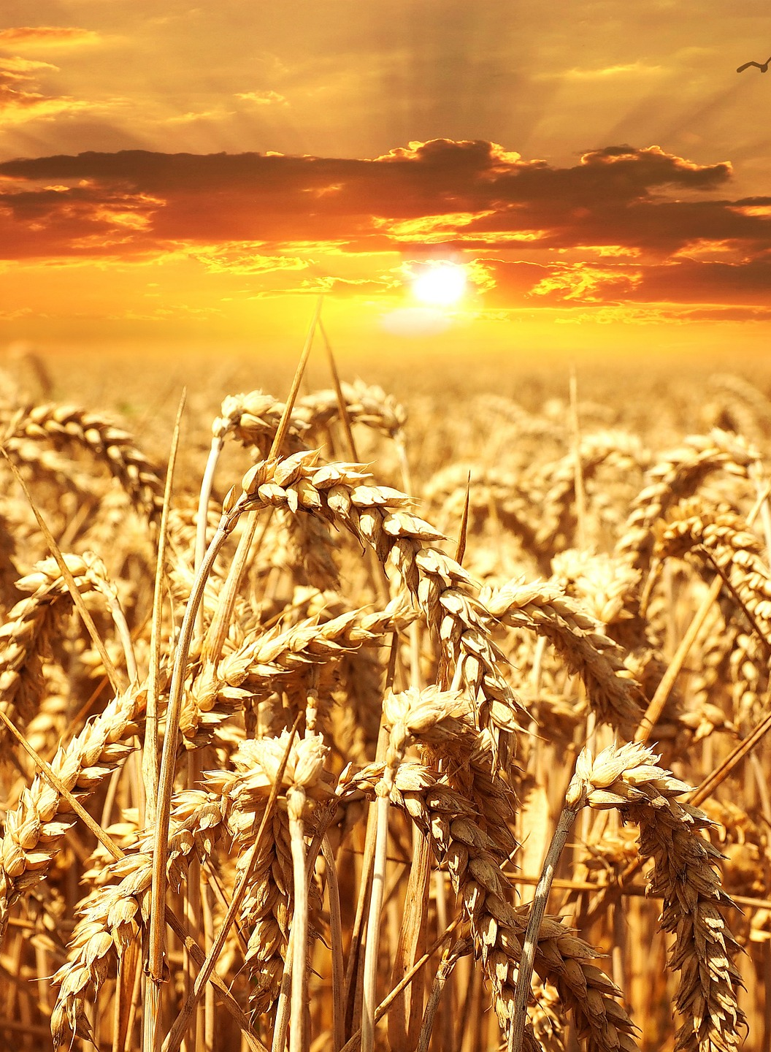
BLOCK 1
The seed II
Understanding the reproduction power
Seed reproduces its own kind. • Why is there no financial development? • The two major investment fields. • God is our total source.

Slide 2
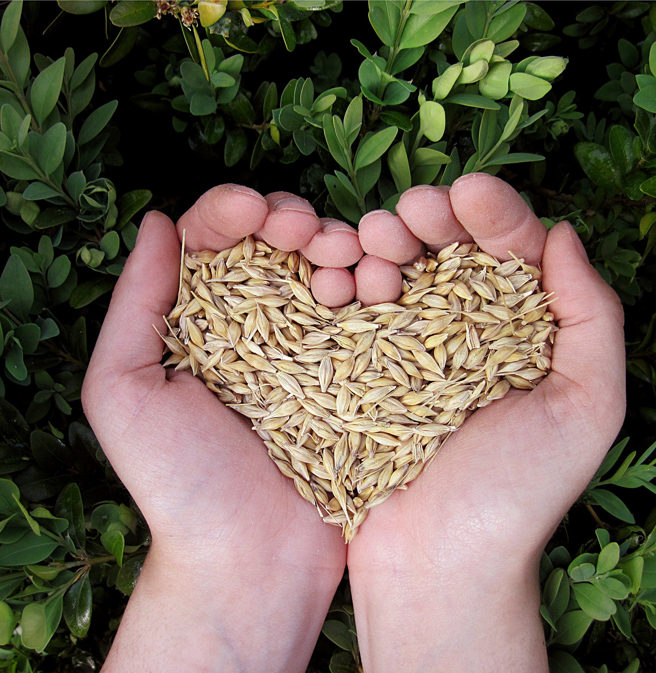
1.
Seed reproduces its own kind
many times
 Paul equalizes money and seed
 2 Cor. 9:6-11
 Money operates by the same rule as seed

Slide 3

1.
Seed reproduces its own kind
many times
How SEED POWER works in agriculture
 Gen. 1:11-12
 When God created heaven
and earth he started this
reproduction process
 Money will produce
more money
Notes:
Gen 1:11-12 “Then God said, Let the earth bring forth grass, the herb that yields seed, and the fruit tree that yields fruit according to its kind, whose seed is in itself, on the earth”; and it was so.
And the earth brought forth grass, the herb that yields seed according to its kind, and the tree that yields fruit, whose seed is in itself according to its kind. And God saw that it was good”.

Slide 4
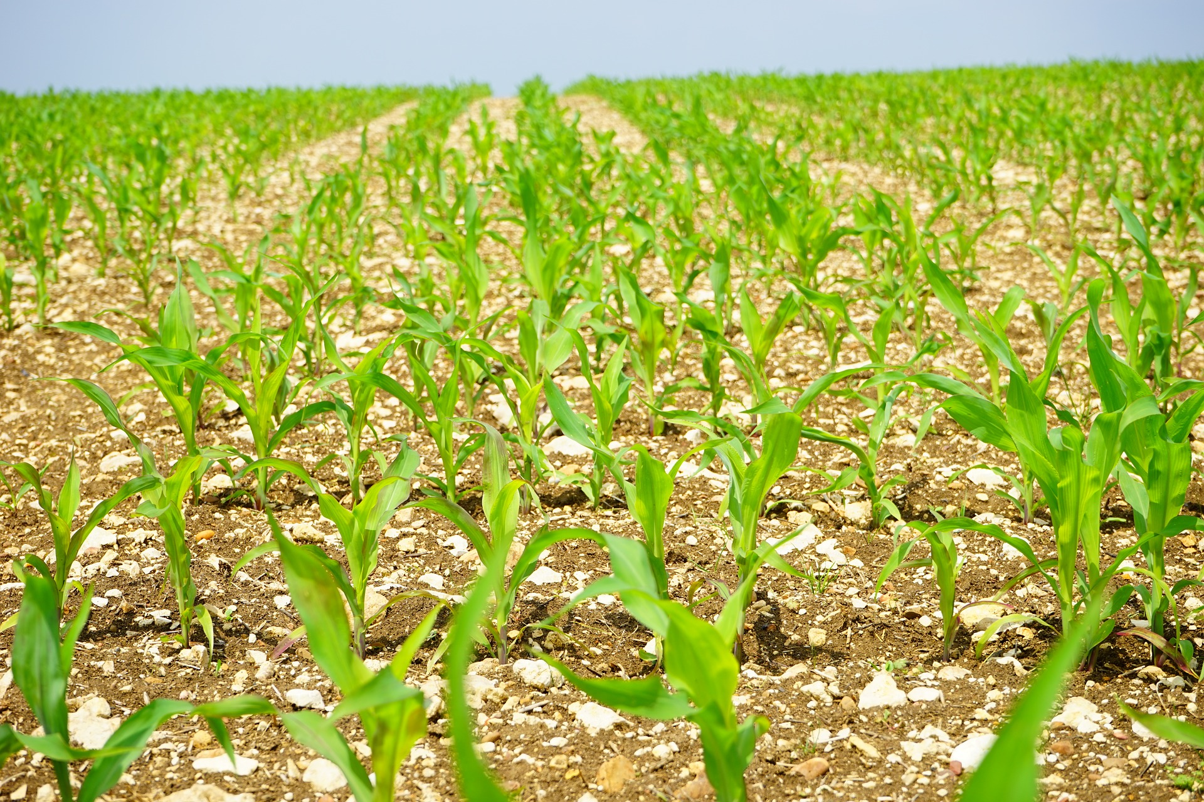
1.
Seed reproduces its own kind
many times
How SEED POWER works in agriculture
 Matt 25:29
 Mark 4:26-29
 The seed works by its own
power
Notes:
Matt 25:29: “For to everyone who has, more will be given, and he will have abundance; but from him who does not have, even what he has will be taken away”.
Extra material – Compounded interest + real rate interest

Slide 5

POWER in your
Finances
How can you make SEED POWER multiply
your money? Here’s some Examples:
 Savings account
 will bring you interest
 Investments
 e.g. in a livestock or a computer
design business
 Unexpected need
 If you have money of your own you
don't have to borrow and pay interest
Notes:
We can work hard to get money, but when money is invested, it works by its own power to bless us with better finances.

Slide 6
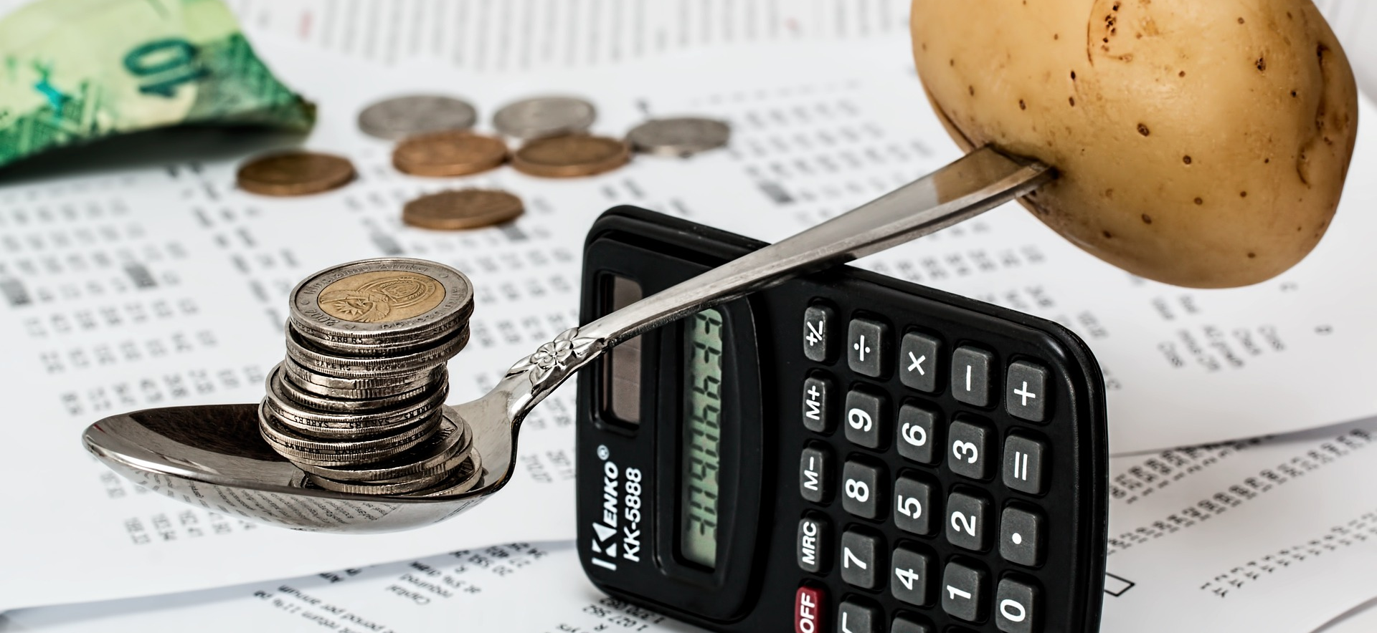
2. Why is there
no financial
Development in some people's lives?
 I'm poor, my income is too small
 “I earn too little.”
 “I have to live from hand to mouth.”
 God is your Provider and he wants to change your situation!
 Read Fil. 4:19

Slide 7
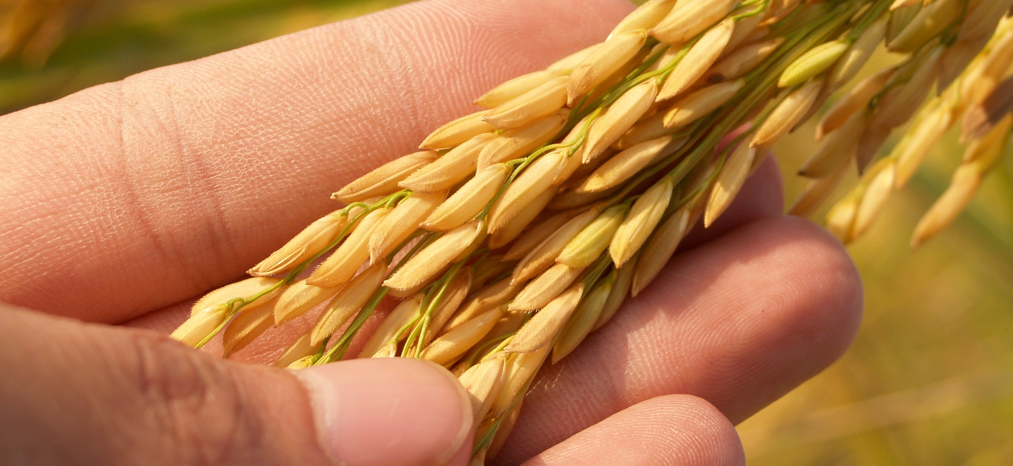
2. Why is there
no financial
Development in some people's lives?
 My seed is insignificant
 “My savings are too small.”
 “It's no use to sow it.”
 Jesus told us about the mustard seed
 Read Mark 4:30-32
Notes:
When they start to set aside the seed for savings and investment, it may seem so insignificant that they might think: "Can this really make any difference?“
But once you start to apply it, it will start to work for you and grow and multiply and bring you a financial development. God himself will add his blessing to your action.
As time goes by, the small becomes greater, the insignificant becomes significant, what didn´t seem to make any difference will after a while make a big difference.

Slide 8
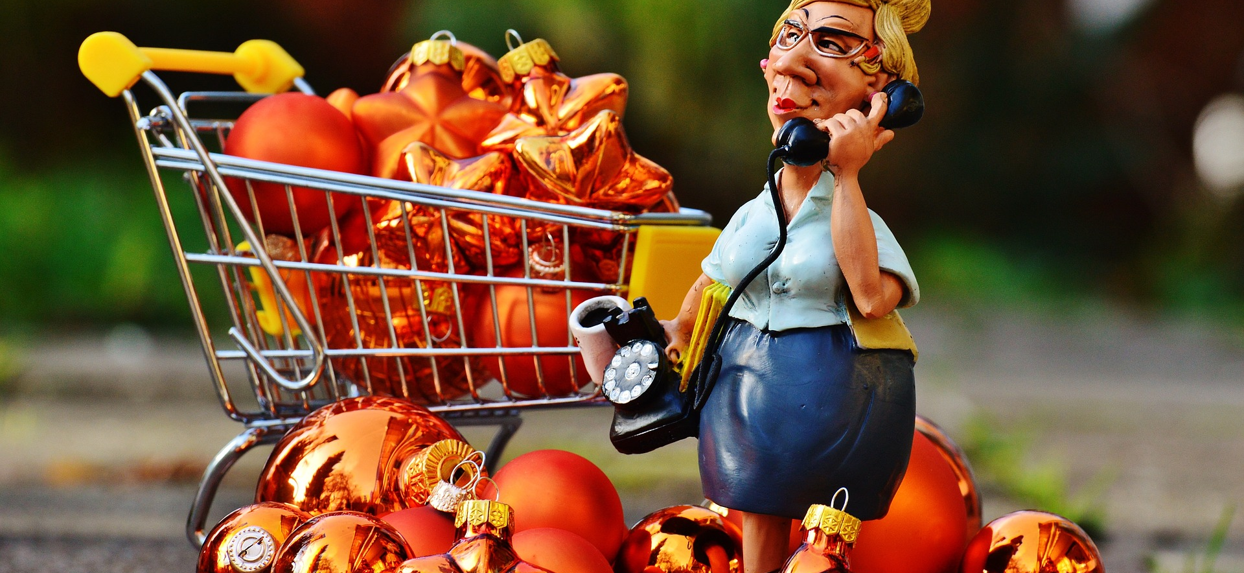
2. Why is there
no financial
Development in some people's lives?
 I'm stuck to bad habits and bad planning
 “My income is up and down.”
 “I spend all my money at once.”
 “I have no plans for the future”
 Change your habits – Start to set aside Seed money!
Notes:
If there are bigger incomes for a while, they don´t set aside money.
They just use the opportunity to consume more.
They should take advantage of the situation, change their habits
and start to set aside seed money!

Slide 9
2. Why is there
no financial
Development in some people's lives?
 Be patient!
The SEED POWER is a mighty tool
to break poverty when it is implemented
over a longer period.
Notes:
That is, the more you can set aside money or increase assets, the stronger your finances.
When you have more money and assets, you can invest more in new projects. A positive development will start in your life, constantly improving and adding to your wealth.

Slide 10
HEY!!!
DISCUSS WITH A
DO
FELLOW STUDENT!
YOU Get
 How could I invest and make
Seed Power multiply my money?
 Are there obstacles in my way of
thinking that hinders me from
saving seed money and invest?
THIS
MESSAGE?

Slide 11
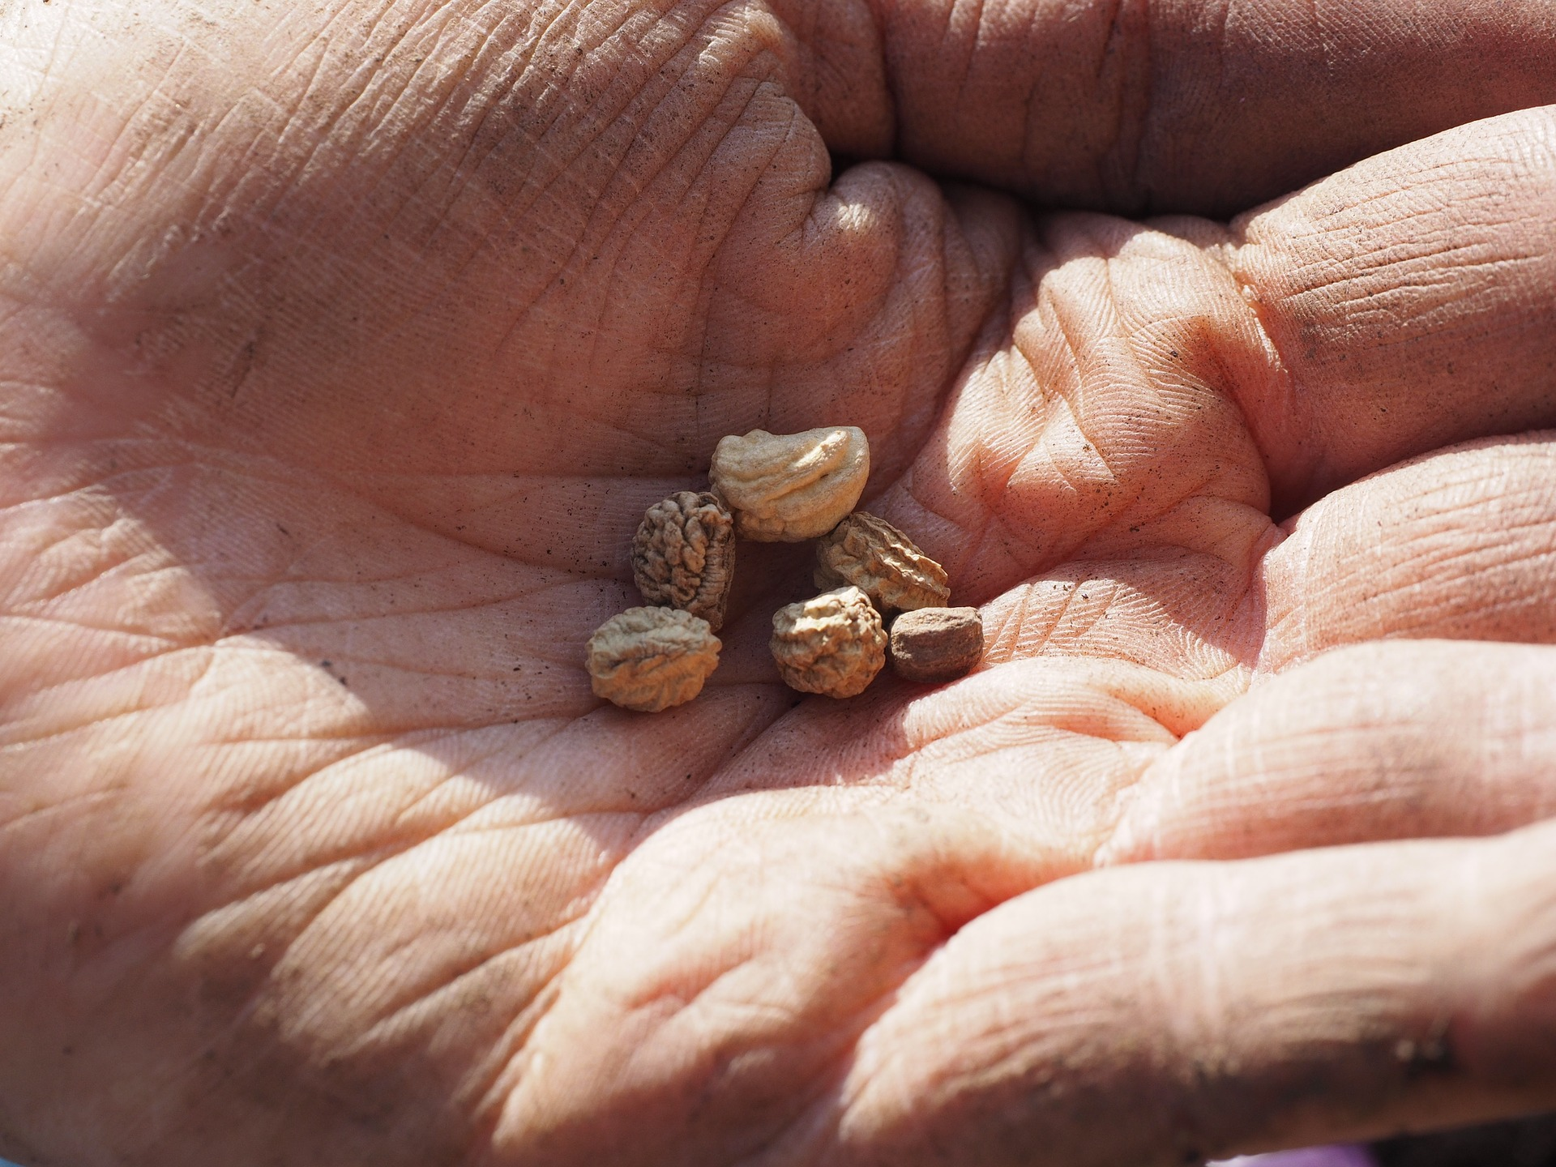
3. Where
to sow?
Now that we know
 what the financial seed is
 and where to find it
Where should it be planted?

Slide 12

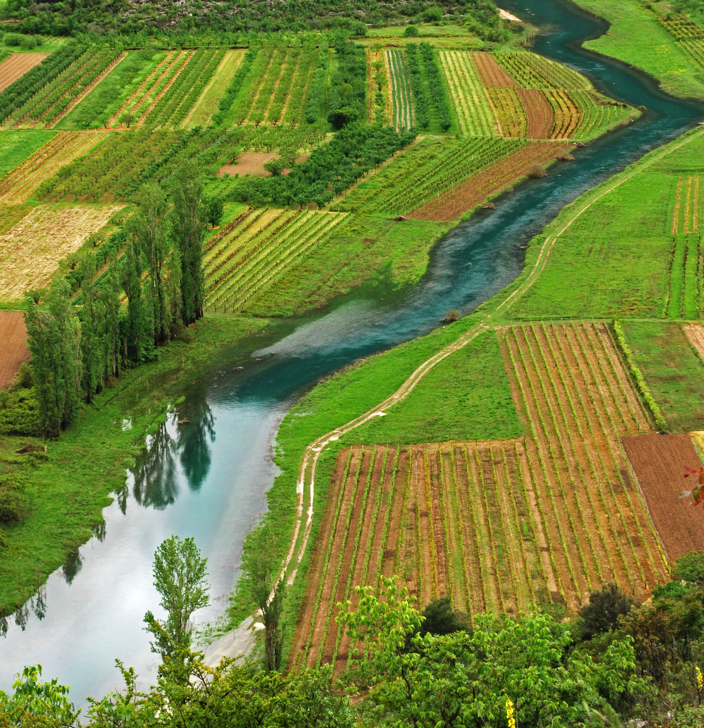
3. The two major investment fields
Where to sow?
The spiritual field of God’s kingdom
The natural field of the creation
Notes:
since we live in two dimensions at the same time – the spiritual and the natural, we can choose to put our money in two different fields and get back a return:
the spiritual field of God´s kingdom
the natural field of the creation

Slide 13
4. Sowing in the
spiritual field
Tithing
 2 Cor. 8:9
 Gal. 3:13-14
We are blessed financially because Jesus became accursed on the cross and released the blessing of Abraham on us.
 Mal. 3:10-12 “When we faithfully give God our tithes, then the windows
of Heaven will open. And God will pour His blessings upon us.”
Notes:
2 Cor 8:9: “For you know the grace of our Lord Jesus Christ, that though He was rich,
yet for your sakes He became poor, that you through His poverty might become rich”
First and foremost, financial blessing upon our lives does not depend on our deeds, but is a result of Jesus becoming a curse on the cross on our behalf, and releasing the blessing of Abraham on us
Mal 3:13-14: “Bring all the tithes into the storehouse, that there may be food in my house, and then try Me now in this, Says the Lord of hosts, If I will not open for you the windows of heaven and pour out for you such blessing that there will not be room enough to receive it.”

Slide 14

4. Sowing in the
spiritual field
Giving
 Luke 6:38
Jesus said: "Give and it will be given unto you, a good measure,
pressed down shaken together and running over, will be given in
your bosom."

Slide 15
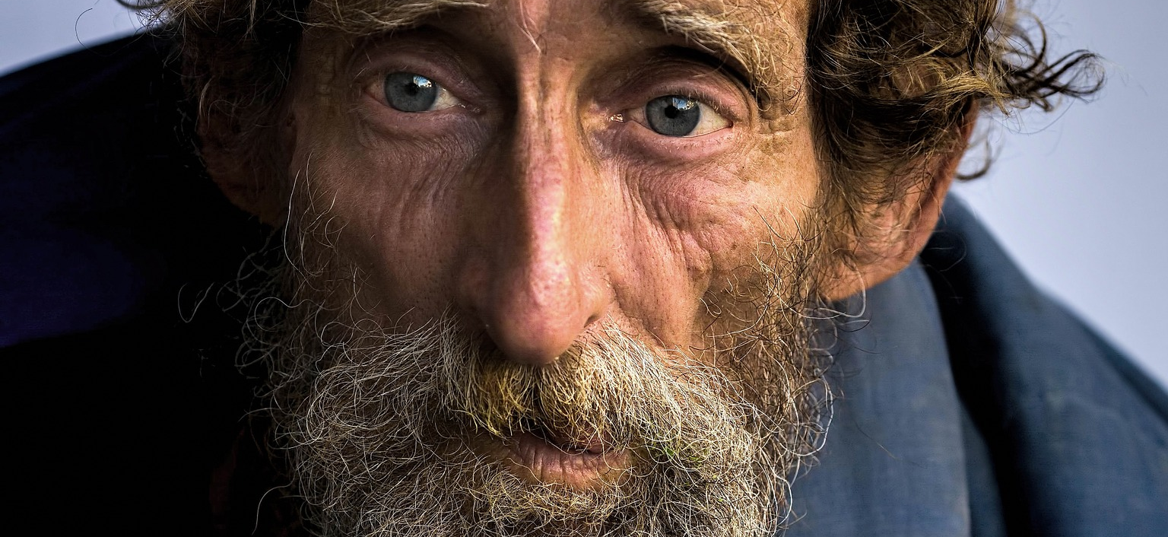
4. Sowing in the
spiritual field
Alms
 Prov. 19:17
If we have pity on the poor we are lending to the Lord and He will
pay us back for what we have done.
If we are faithful to God, he will be faithful to us
Notes:
So part of what you have, and what you call your income, is seed that God has supplied you with and that he intended you should give back to him, just as the farmer returns his seed to the field he got it from.
This money is not intended to meet your own needs, but your contribution in making God´s plans real on earth. God has called us to be his co-workers and he has given us the privilege of financing parts of what he is doing.
We must always remember that nothing we have actually belongs to us, everything belongs to God (Ps 24:1).

Slide 16
5. Sowing in the natural field
 The "natural field" means
business opportunities
that are available for you.
Our God is the
God of Abundance.
His name is El Shaddai.
 God wants us to enjoy
life and be able to take
care of ourselves and
our families without
perpetual scarcity.
Notes:
God has given us the possibility to use the creation for the purpose of supporting us and creating wealth.

Slide 17
5. Sowing in the
natural field
Your part is hard work, wise money management and wealth creation.
 This cannot be neglected if you want God's
blessings to be fulfilled in your finances
 Make God The Holy Spirit your
business advisor!
Let God's wisdom show you where to plant your
seed. Pray! Ask The Holy Spirit for instruction!
Do what he says in a disciplined way!
Notes:
As Jesus taught us, not all fields that the seed is sown into will yield fruit. If the seed is sown in the wrong field, the investment can be lost or the return too small (Mark 4).
In the same way, God wants to instruct you in your business decisions, how to reach out your hand and seize the opportunities that God provides. Make sure you follow these instructions in a disciplined way. Listen to the small voice inside of you.

Slide 18
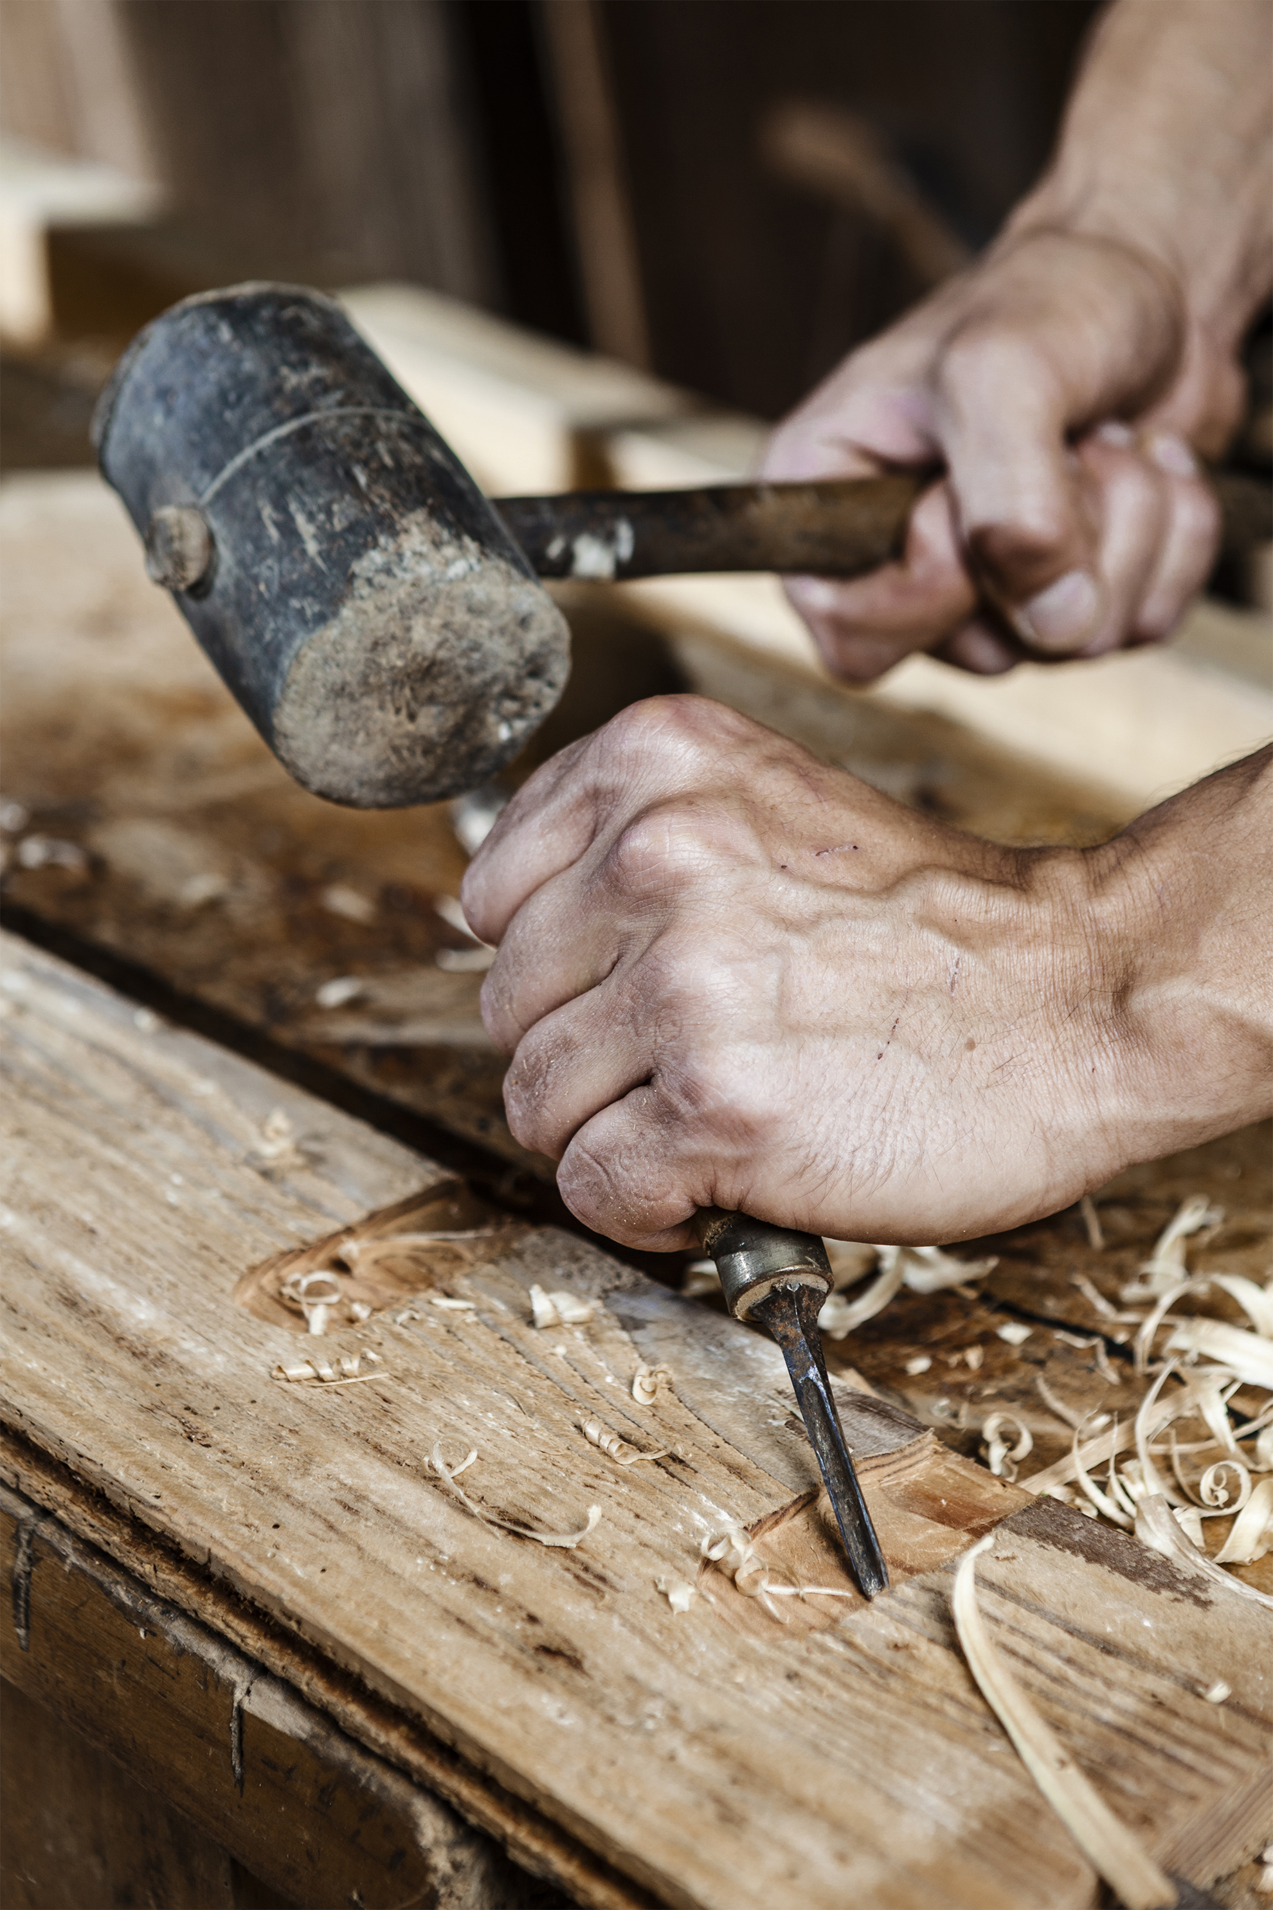
5. Sowing in the
natural field
- Some guidelines:
 Deut 28:8 - The Lord will bless the works
of your hands
a) What are your hands good at?
b) What have your hands done before?
c) What can your hands/mind be
trained to do?
You will earn money with your skills
Notes:
a) What comes naturally? This shows God’s gifts in you and what you’re good at will create the opportunity for business
b) What experience do you have? Your former experience is usually a natural steppingstone into business.
c) What experience do you have? Your former experience is usually a natural steppingstone into business.

Slide 19
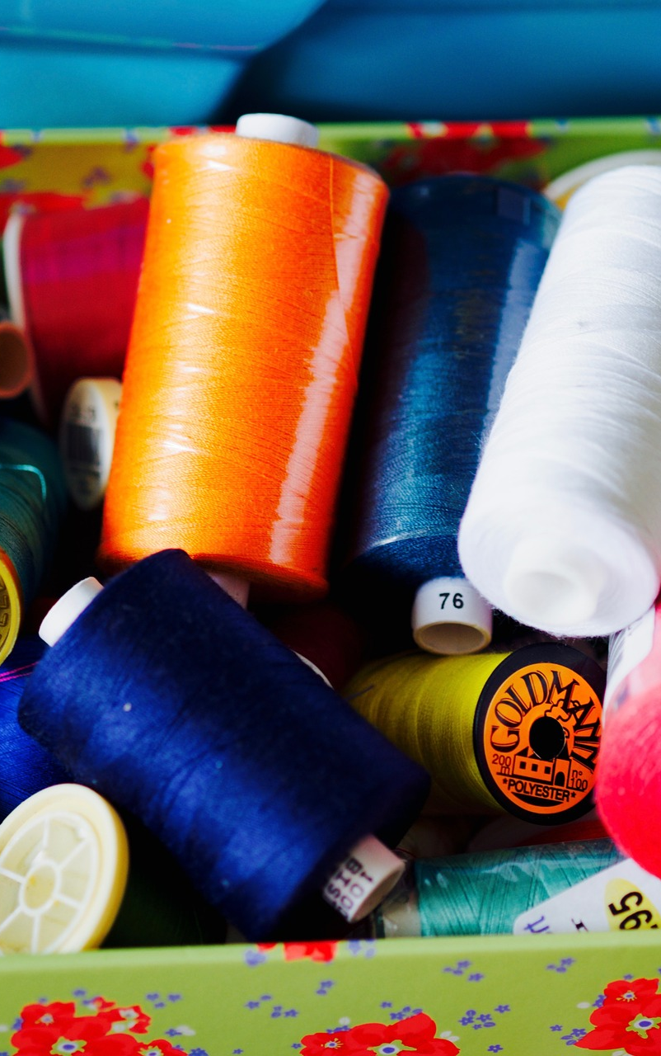
5. Sowing in the
natural field
- Some guidelines:
 Neh 8:10
– The joy of the Lord is our strength
a) What do you enjoy doing?
It is easier to become good at something
you enjoy doing.
Notes:
a) Do you have an attraction to/interest in a certain trade/profession? It is an expression of the talent God has put in you!
A passionate attitude will help you come a long way.

Slide 20

5. Sowing in the
natural field
- Some guidelines:
 2 Cor 2:12 - What are the opportunities?
a) What is the consumer demand?
b) What are others doing?
c) What education is available ?
d) Can you partner with someone?
Be an active person!
Notes:
a) What type of products and services are people asking for? Find a consumer need in your community and fill it- then you have a natural business.
b) If others are doing it, then there is a business that works. Just make sure that there is room for one more player! Then try to be better, cheaper, more efficient and appealing to the customer, than your competitors.
d) Complementing your skills or capital with somebody else.
Be an active person! A person who is active and constantly on the move will find and create opportunities (Acts 16). Such a person will eventually bump into the right business ideas and opportunities.

Slide 21
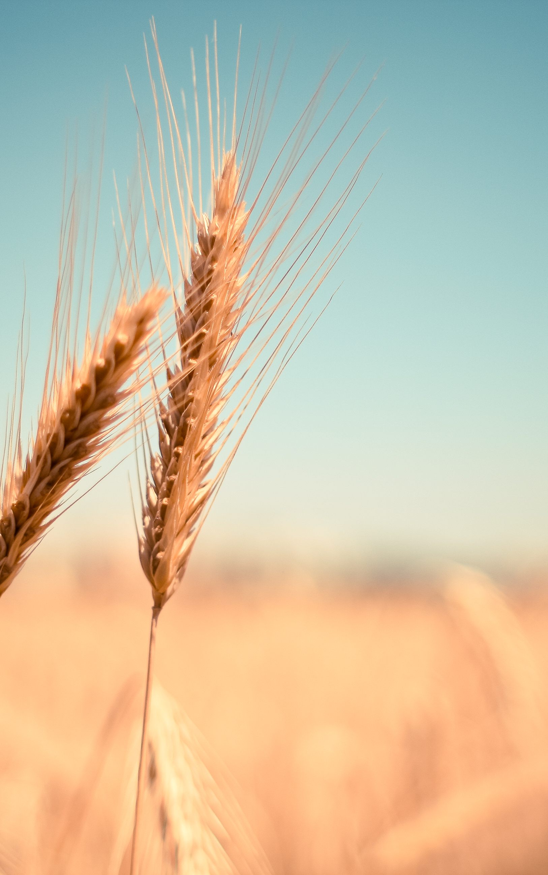
Count with God
 Ps 23:3 a) Trust that the Lord is with you!  Jer 31:9 b) Pray, and be on the move.  James 1:5 c) Ask, and he will give you wisdom  Deut 8:18 Remember – It is the Lord who give
you power to gain wealth!

Slide 22

6. What is
the reason
for us to do business?
 Two kinds of business
 Private business
Examples: Buying houses, land or livestock and then
selling it for a profit
 Corporate business
Examples: A coffee shop, an internet café,
A computer design company
Notes:
Not all can or should do corporate business (living on the business), but everybody can do private business (creating extra incomes). So by being wise and driven, we can put our seed into investments in life that can create a financial development for us.

Slide 23
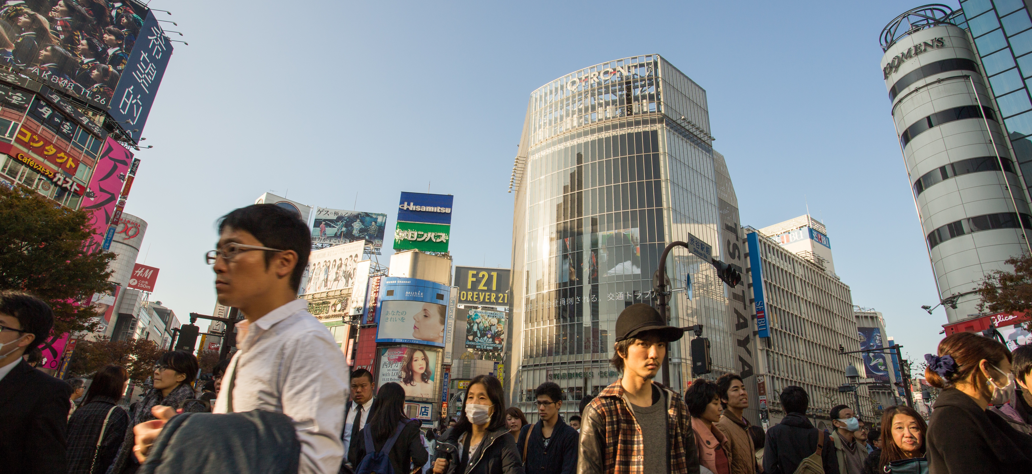
6. What is
the reason
for us to do business?
 Luke 19:13 Jesus told us to do business and multiply
our seed money.
Our stewardship
 We shall increase our wealth
 We shall support the kingdom of God financially
 We shall use the talents and gifts that God has
given to us

Slide 24

7. Always remember
– God is our total source
 2Cor. 9:10
He supplies seed – he multiplies
the seed – he increases the fruit
The blessing of the Lord can make us rich
 It is not about our ability or might
 The Lord gives us power to get
wealth  Deut. 8:18
 We are totally dependent
on God all the time
Notes:
We do our job to invest in the kingdom of God and in the natural. We plant and we water as Paul says in 1 Cor. 3:7, but it is God who gives the increase and makes the harvest possible.

Slide 25
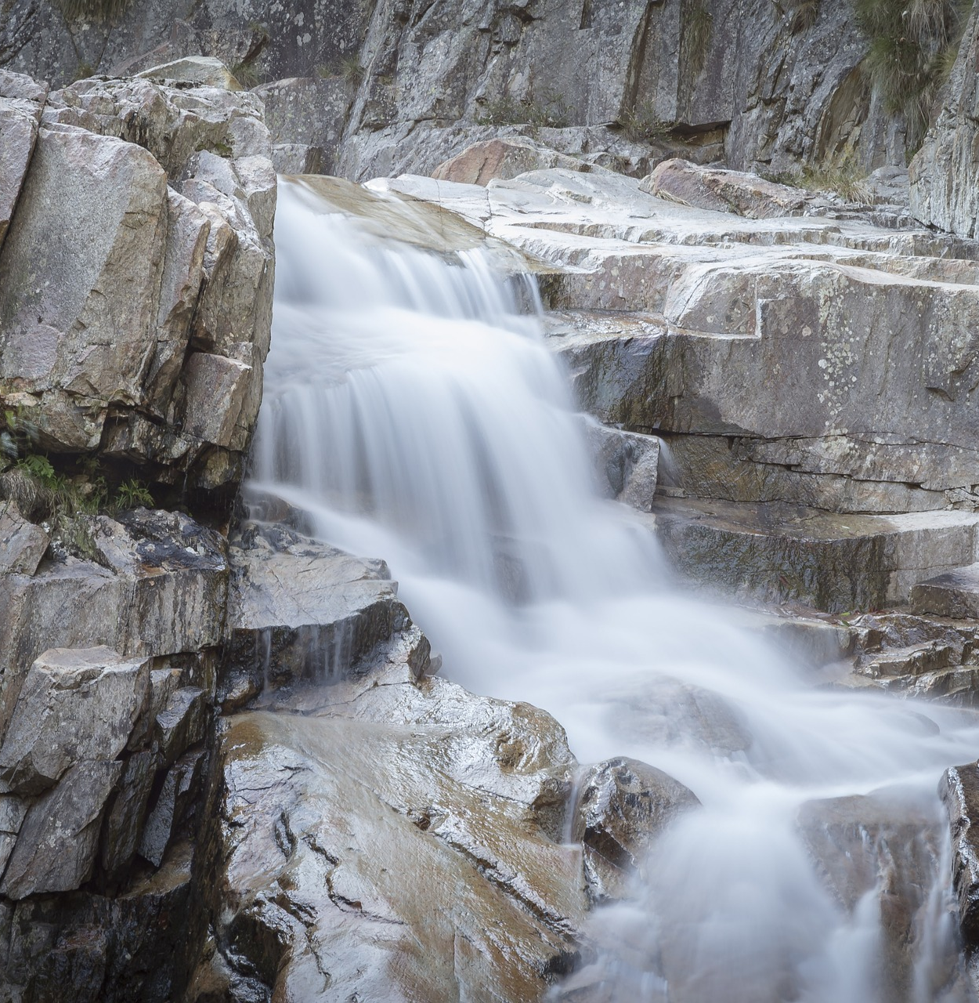
7. Always remember
– God is our total source
We trust our Provider
 He provides to meet our need
 He gives us the investment
for our business and for the
kingdom of God
 He makes it grow so that
more is coming back
Notes:
In this way God is the beginning and the end of our prosperity, the Alpha and the Omega
(Rev. 1:8). We are dependent on him and we trust him all the time.

Slide 26
HOMEWORK
HOME
NOW
WORK
WHAT
 How do I plan to sow seed money
into the kingdom of God?
 Why is tithing so important?
 What business opportunities do I
have and what can I think of?
ABOUT
ME?

Slide 27
HOMEWORK
HOME
NOW
WORK
WHAT
 Which are my talents? What am I good
at? How can this be applied to business?
 What kind of Business would I like
to start?
ABOUT
ME?

Slide 28
THANK
YOU GUYS
THAT´S ALL FOR THIS MOMENT

